Slide 1
Paper Schedule Reports
指導老師：戴天時 老師
楊曉文 老師
學生： 謝昌宏

Slide 2
Outline
What’s Guaranteed Minimum Withdrawal Benefit (GMWB)?
Pricing Method
See Example

Slide 3
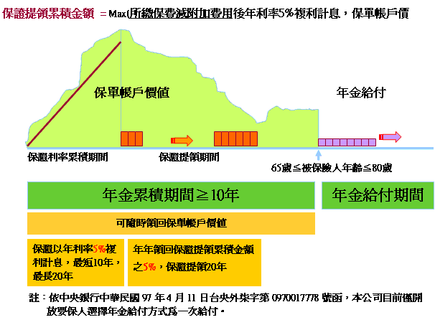
What’s Guaranteed Minimum Withdrawal Benefit (GMWB)?
1.Roll-up(複利增值)
2.Ratchet(鎖高機制)
3. Break even(保本)
Reference Source：中泰人壽 金富貴外幣變額年金保險

Slide 4
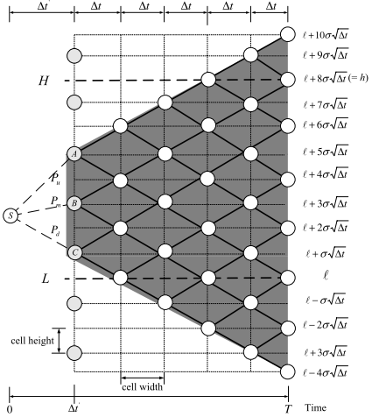
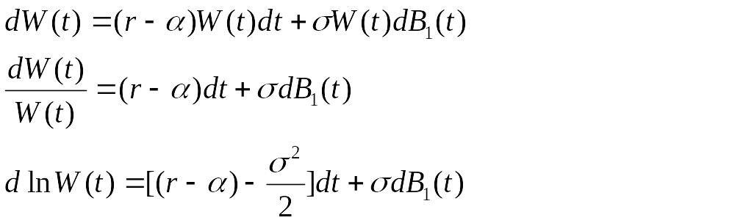
Pricing Method
The Bino-trinomial Tree
1. 延續Milevsky and Salisbury(2006)的設計，假設GMWB所投資的標的資產符合幾何布朗運動
2. 帳戶價值會隨著時間有預期報酬的增加以外，還有公平費用率的收取，若假設公平費用率是連續收取，且保戶不能提前解約，則我們可以將帳戶的隨機過程改為：
Reference Source : The Bino-trinomial Tree: A Simple Model for Eﬃcient and Accurate Option Pricing

Slide 5
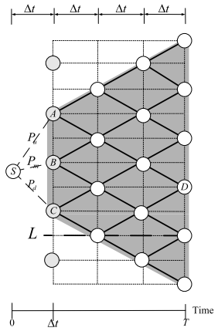
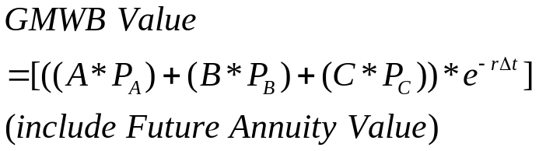
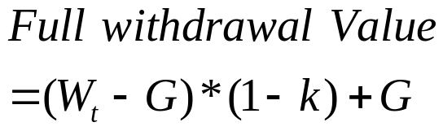
Pricing Method
Optimized withdrawal rate
Vs.
Optimized withdrawal rule reference Kwork - GUARANTEED MINIMUM WITHDRAWAL BENEFIT IN VARIABLE ANNUITIES
Reference Source : The Bino-trinomial Tree: A Simple Model for Eﬃcient and Accurate Option Pricing

Slide 6
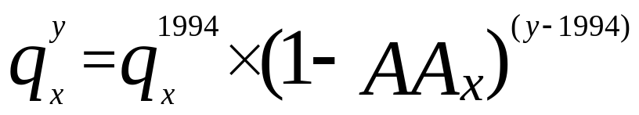
Pricing Method
Death Rate - Reduction factors
GAM-94（1994）：
The value of AAx refer to “1994 GROUP ANNUITY MORTALITY TABLE AND 1994 GROUP ANNUITY RESERVING TABLE”.

Slide 7
Pricing Method
Wang Risk Transform
Given a distribution function F, its Wang transform is deﬁned as
where F(x) is the distribution function corresponding to the standard Normal distribution and λ is a parameter called the market price of risk.
Risk-Neutral Death Rate
Real-world Death Rate

Slide 8
Pricing Method
SECURITIZATION OF LONGEVITY RISK: PRICING SURVIVOR BONDS WITH WANG TRANSFORM IN THE LEE-CARTER FRAMEWORK
In Belgium, is the appropriate proxy for the market price of an annuity sold to an 65-year-old individual.
i = 3.25%, and is the probability that a 65-year-old annuitant does not reach age 65 + t.
They get λ65(2005) = −0.4722883 for men and −0.2966378 for women.

Slide 9
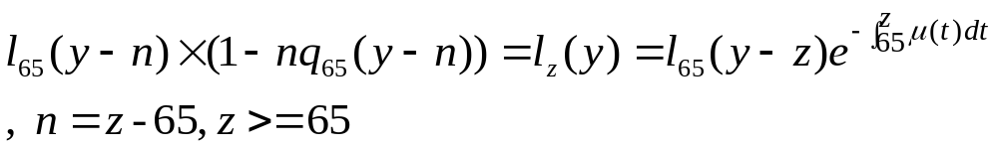
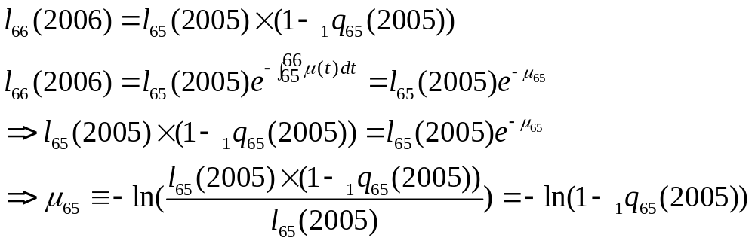
Pricing Method
Death Rate - Transform Death Rate
在此我們令65歲時仍生存的人數為基準，來算出各個年齡下的瞬時死亡率，例如：在2005年為65歲，其未來一年內瞬時死亡率為：

Slide 10
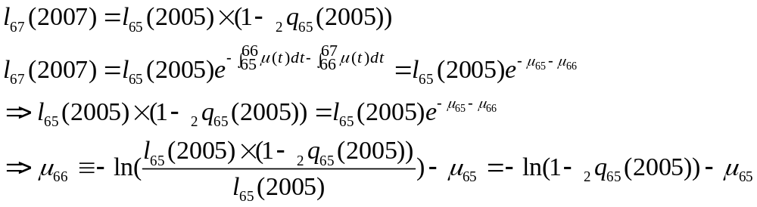
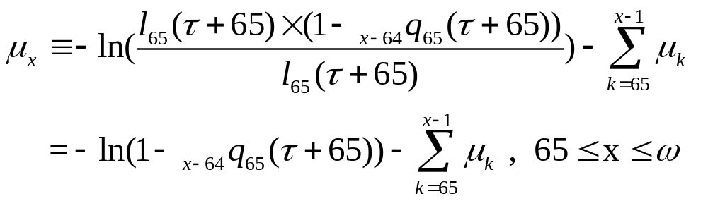
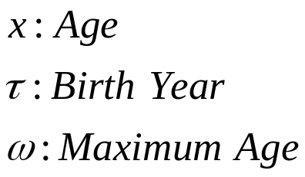
Pricing Method
Death Rate - Transform Death Rate
其66歲時，未來一年內的瞬時死亡率為：

Slide 11


Pricing Method
Death Rate
將一年分成m期，每期時間長度為
從65歲購買GMWB的那一刻往後經過2期 的時間，投保人的生存機率為：
65

Slide 12
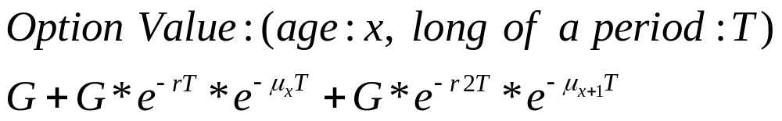
Pricing Method
When hit the boundary
Discount factor
Conditional probability of living
Living
G
Living
G
Death
0
Death
0

Slide 13
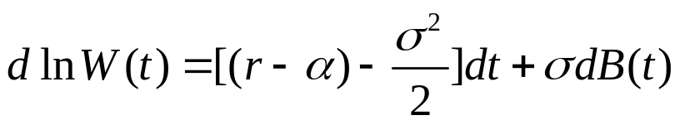
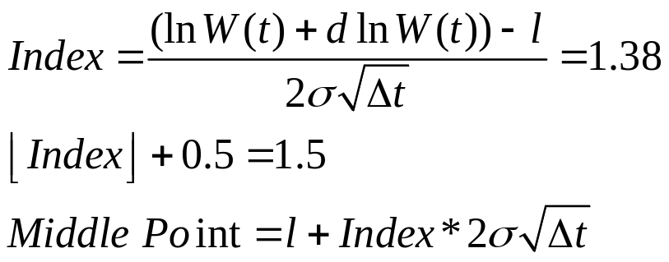
See Exapmle
CRR
Find BTT Middle Point
4.972
2*CellHeigh
4.605
4.548
CRR steps is odd:
4.499
4.124
3.912
Boundary
Reference Source : The Bino-trinomial Tree: A Simple Model for Eﬃcient and Accurate Option Pricing

Slide 14
See Example
First year
5.18(178.54)
4.97(144.41)
2*CellHeigh
4.605(100)
4.55(94.48)
4.76(116.81)
4.34(76.42)
4.12(61.82)
3.91(50)
CellHeigh
Boundary

Slide 15
See Example
Withdrawal G
5.18(178.54)
4.97(144.41)
4.86(128.54)
4.605(100)
4.55(94.48)
4.76(116.81)
4.2(66.81)
4.34(76.42)
4.12(61.82)
3.27(26.42)
3.91(50)
Boundary
0

Slide 16
See Example
Second year
5.18(178.54)
178.54
4.97(144.41)
4.86(128.54)
4.605(100)
4.76(116.81)
116.81
4.55(94.48)
4.34(76.42)
76.42
4.12(61.82)
4.2(66.81)
3.91(50)
50
Boundary
3.27(26.42)
32.71
0
21.4
14

Slide 17
See Example
Calculate final value
5.18(178.54)
178.54
4.97(144.41)
4.86(128.54)
4.605(100)
4.76(116.81)
116.81
4.55(94.48)
4.34(76.42)
76.42
4.12(61.82)
4.2(66.81)
3.91(50)
50
Boundary
3.27(26.42)
32.71
50
0
21.4
14

Slide 18
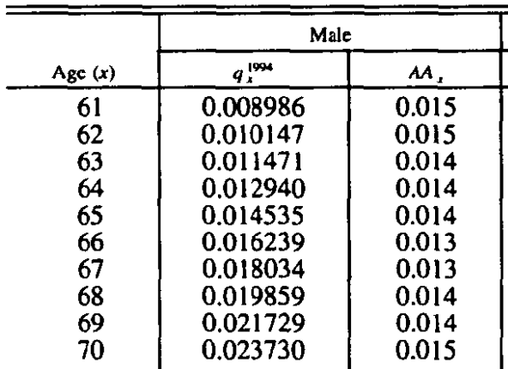
See Example
Forecast probability of death(Age>=65)

Slide 19
See Example
Forecast probability of death(Age>=65)
Ex: q65(2005)=q65(1994)x(1-AA₆₅)⁽²⁰⁰⁵⁻¹⁹⁹⁴⁾=0.019016
q66(2006)=q66(2004) x(1-AA₆₆)⁽²⁰⁰⁶⁻¹⁹⁹⁴⁾=0.0207688

Slide 20
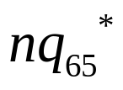

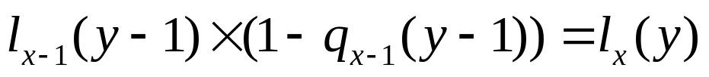
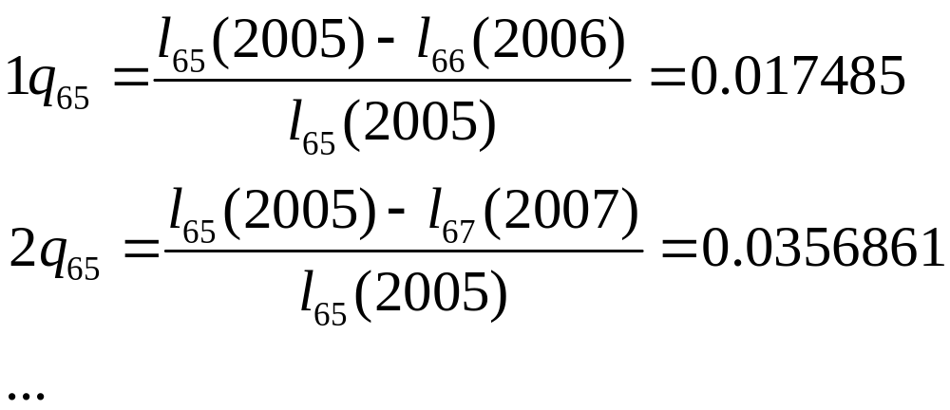
See Example
Calculate risk-neutral (n=1,2,3,…)
1.calculate (總生存率), x>=65
2.

Slide 21


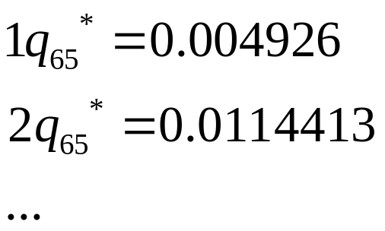
See Example
Calculate risk-neutral
3.
λ65(2005) = −0.4722883 for men

Slide 22
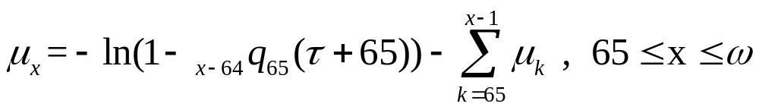
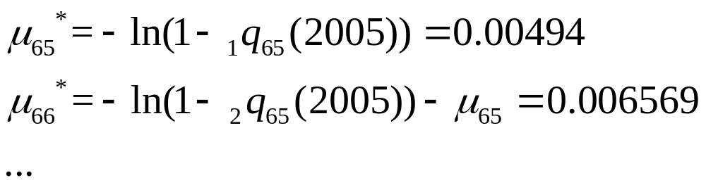
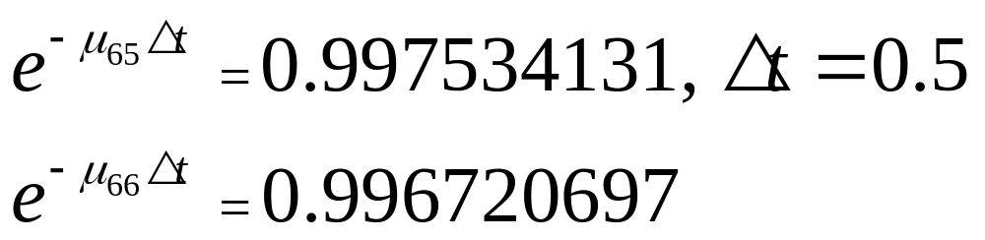
See Example
Calculate risk-neutral conditional death force
Conditional Survival Probability:

Slide 23
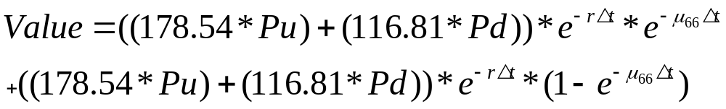
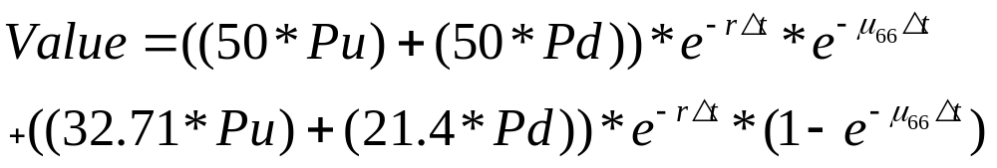
See Example
Backward induction - CRR
Pu
178.54
Survival value
Pd
116.81
Death value
76.42
50
Boundary
32.71
50
21.4
14

Slide 24
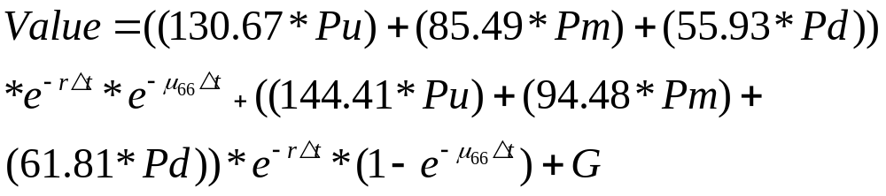
See Example
Backward induction – first term
(178.54)
130.67(144.41)
Pu
Survival value
Pm
85.49(94.48)
Pd
55.93(61.81)
Death value
Vs. (we choice the higher)

Slide 25
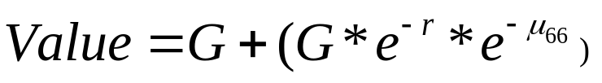
See Example
Backward induction – hit the boundary
(178.54)
130.67(144.41)
Pu
Pm
85.49(94.48)
Pd
55.93(61.81)

Slide 26
Thanks for your attation

